Slide 1
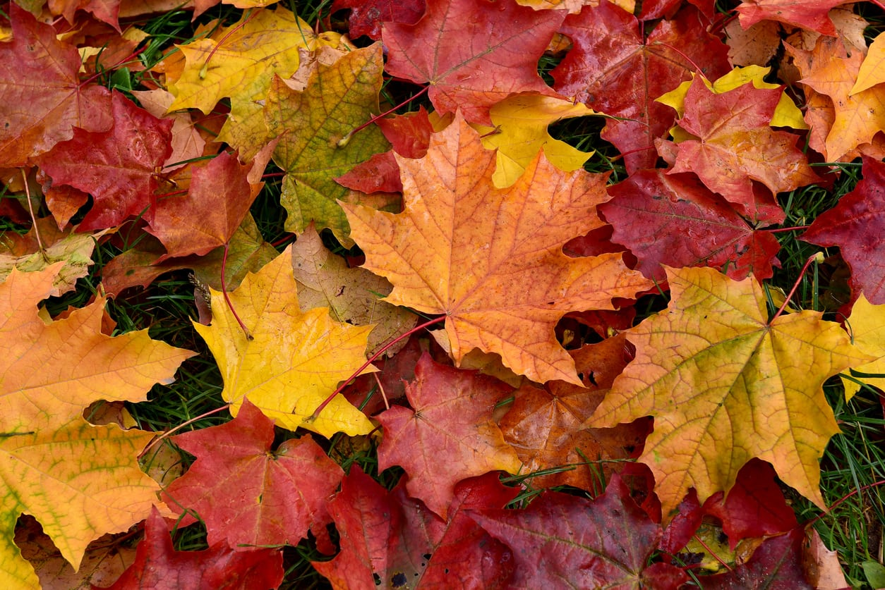
Class 4 Autumn Term 1: September – October 2021
History
Who were the ancient Greeks?
What was life like for the ancient Greeks?
What did the ancient Greeks do for us?
Was Alexander the Great really great?
What is democracy and why is it a good thing?
Maths
Term 1: Place value; Four operations
Term 2: Fractions; Geometry (position & direction)
Geography
Where is Greece?
How has Greece changed over time?
What makes Greece such a popular place to visit?
PE
Term 1: swimming and invasion games (tag rugby)
Term 2: swimming and athletics / orienteering
RE
We follow the Oxford Diocese scheme of work.
Term 1: Do Muslims need the Qur’an? (Islam)
Term 2: Does God communicate with humans? (Christianity)
Class Text (Term 1)
Science
Gravity and other Forces
French
Recap on the basics from previous year
Tout sur moi! – All about me!
Design Technology
Design Brief: design and make an Archimedes screw to transport cereal from one container to another.
PSHE
Me and my relationships / Valuing difference
Computing
Online Safety
Coding
Class Text (Term 2)

